Slide 1
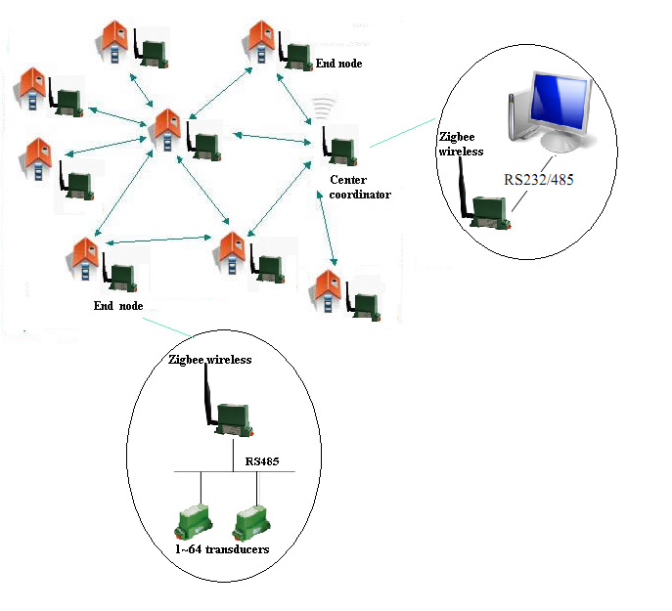
ZIGBEE
WIRELESS
NETWORK
By
ANAND
MANJUNATHA
MANJUNATHA
PHILEMON CHAWANG
Guided by
Harish V Mekali

Slide 2
Communi-
-cation
What is communication
Different types of communication
Highlight zigbee

Slide 3
What is a typical zigbee?
What
Is
ZigBee?
Why zigbee?

Slide 4
….
Zigbee layers
Zigbee specification
….

Slide 5
[BLOCK GENERAL REPRESENTATION]
BLOCK DIAGRAM

Slide 6
COMPONENTS
USED

Slide 7
ARM CORTEX-M0
[BLOCK REPRESENTATION]
[GENERAL WRITE-UP]

Slide 8
SOIL MOISTURE SENSOR
[BLOCK REPRESENTATION]
[GENERAL WRITE-UP]

Slide 9
LCD 16X2 DISPLAY
[BLOCK REPRESENTATION]
[GENERAL WRITE-UP]

Slide 10
ZIGBEE TARANG BASE-BOARD
[BLOCK REPRESENTATION]
[GENERAL WRITE-UP]

Slide 11
ZIGBEE CONFIGURATION PROCESS
[FIGUES IF ANY]
[GENERAL WRITE-UP]

Slide 12
CONCLUSION

Slide 13
FUTURE
WORK

Slide 14



TEQIP
SPONSORS

Slide 15


